Slide 1
Capstone Design Project2_Seokju Koh
High Availability System
in Cloud Environment
using WAS Clustering
TEAM 5
2012105055 JongYoung Son
2016115113 SunHee Kim
2016117078 HyunKyung Cho
2016114418 KeunRyeong Bae

Slide 2
Contents
Team Introducing
About Project
Timeline
Team members
Activities
Background
System Outline
Project Progress
Paper Plan
Project Plan
Future Plan
Going to Introduce the Project and the Plans

Slide 3
Ⅰ. Team Introducing
Team Members
Activities

Slide 4

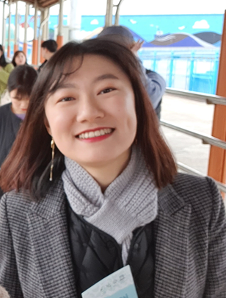

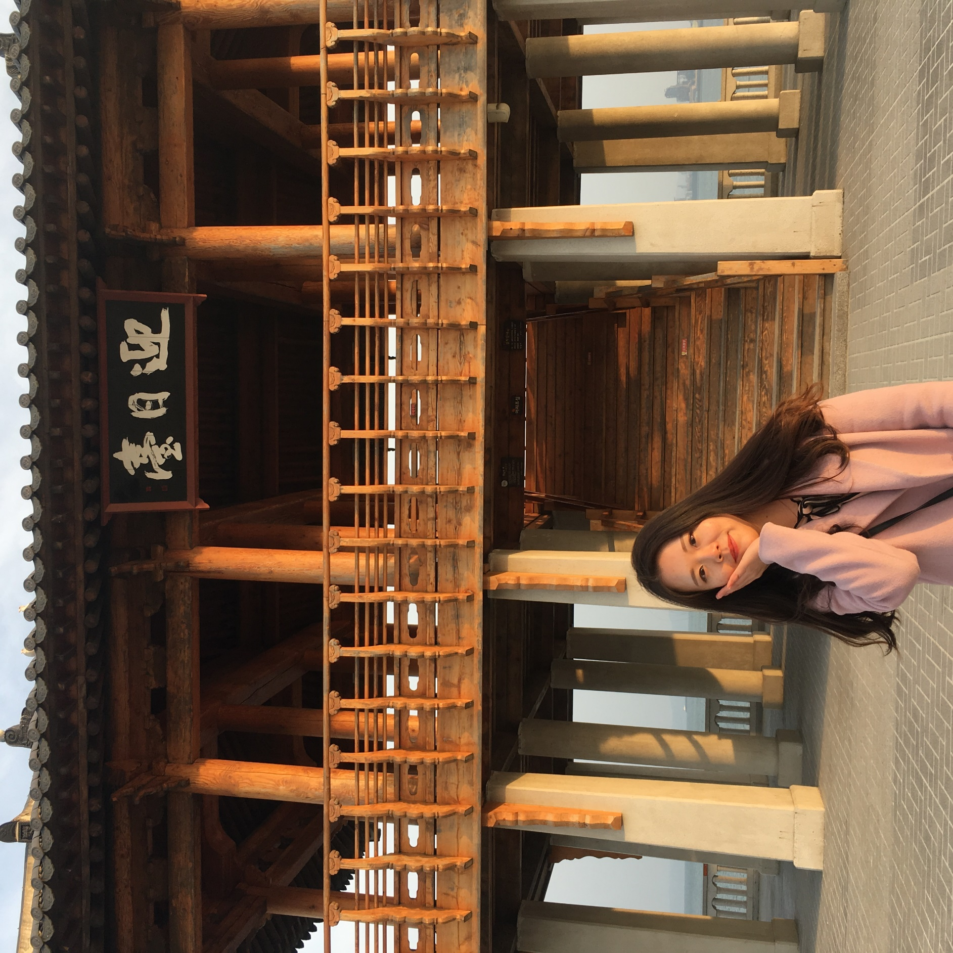
Ⅰ. Team Introducing
Team Members
Construct cloud environment
System Integration
Construct testing environment
System testing
Construct WEB/WAS server
Manage Trello
Construct session clustering
Manage Git
JongYoung Son
KeunRyeong Bae
HyunKyung Cho
SunHee Kim

Slide 5
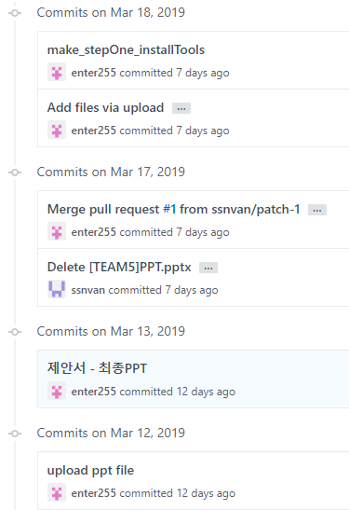
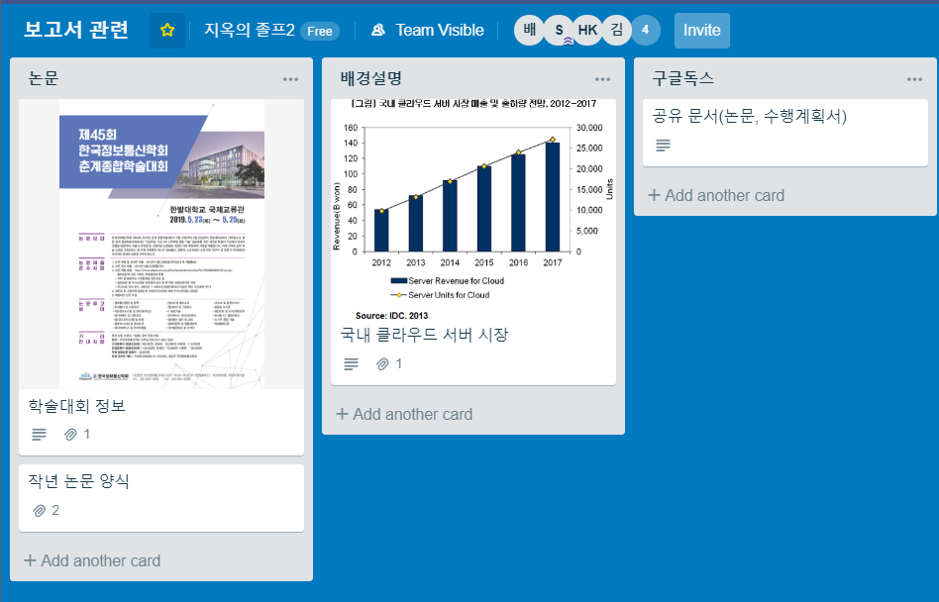
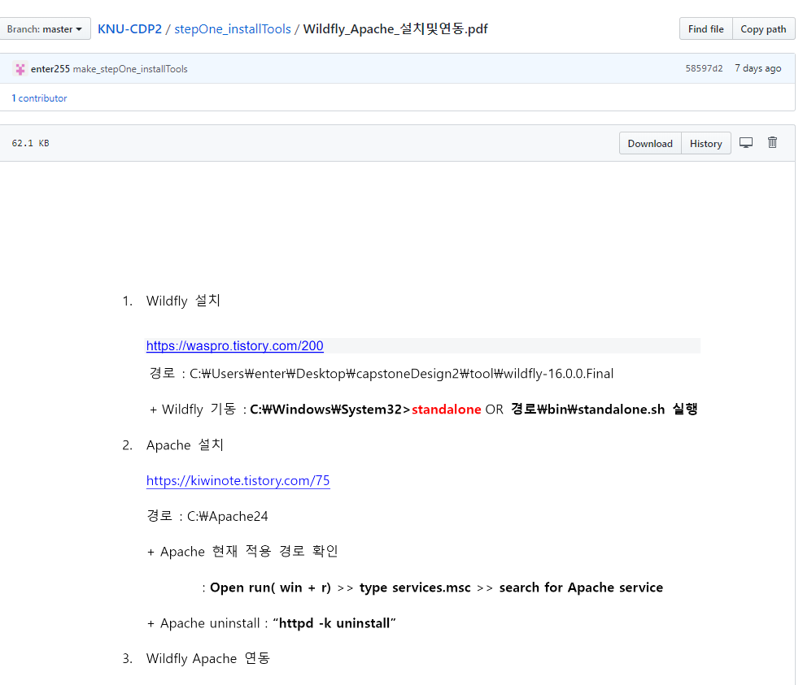
Ⅰ. Team Introducing
Activities
Trello
Github
Materials and Schedule Management
Project Documents and Sources Management

Slide 6
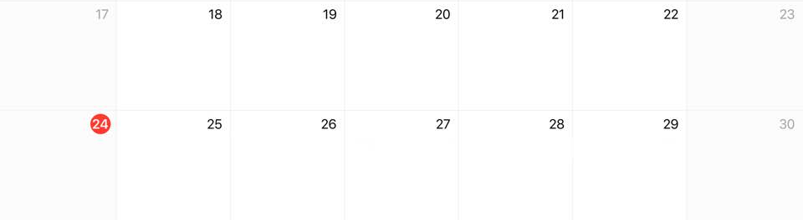
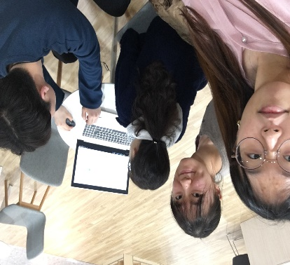
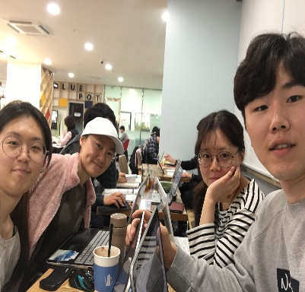
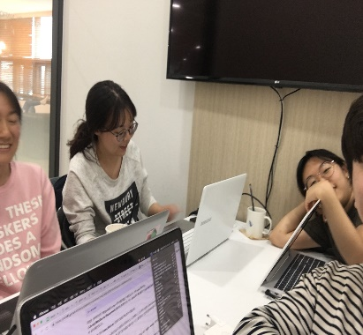
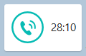
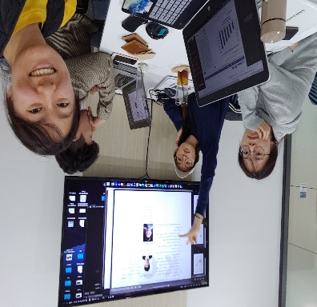
Ⅰ. Team Introducing
Activities
Offline & Online
Today

Slide 7
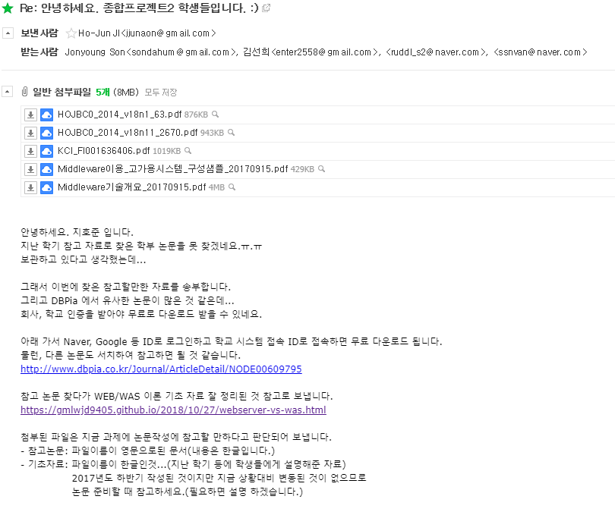
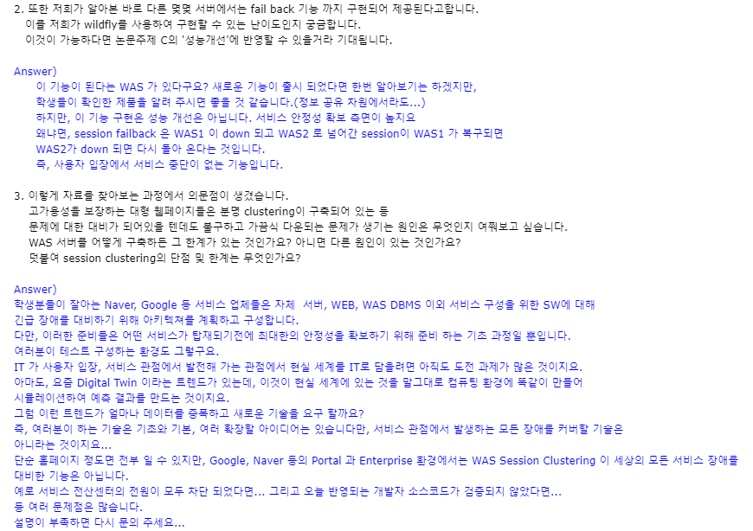
Ⅰ. Team Introducing
Activities
E-mail Contact

Slide 8
Ⅱ. About Project
Background
System Outline
Project Progress

Slide 9
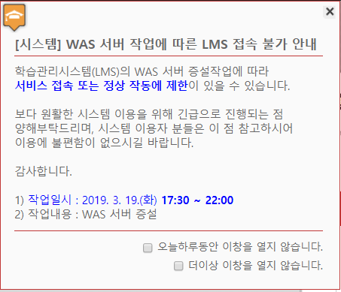


Ⅱ. About Project
Background
『WAS Session Clustering』
Notes:
우리는 실제로 퍼블릭 클라우드 환경에서 구성된 웹 서비스에 web, was 구성을 이중화하고 2개의 was를 session clustering하여
하나의 어플리케이션에 문제가 생기더라도 전체 서비스에 영향을 주지 않는 고가용성 시스템을 구축하여 공공기관이나 기업체등에서 사용할 수 있는 안전한 오픈소스 웹 시스템을 구축하려한다.

Slide 10






Ⅱ. About Project
System Outline
Cloud
WAS1
Web Browser
WEB
WAS2

Slide 11



Ⅱ. About Project
System Outline
『WAS1』
『WEB』
Web Browser
『WAS2』

Slide 12
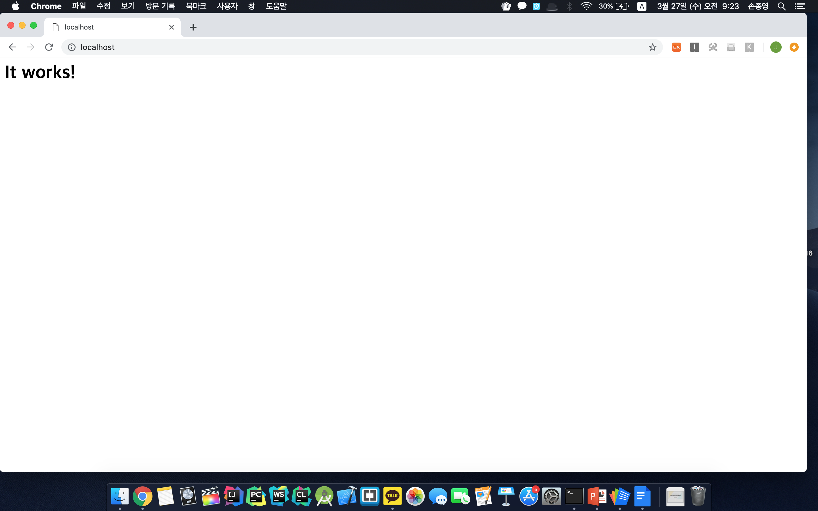
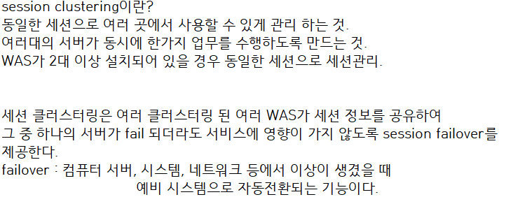
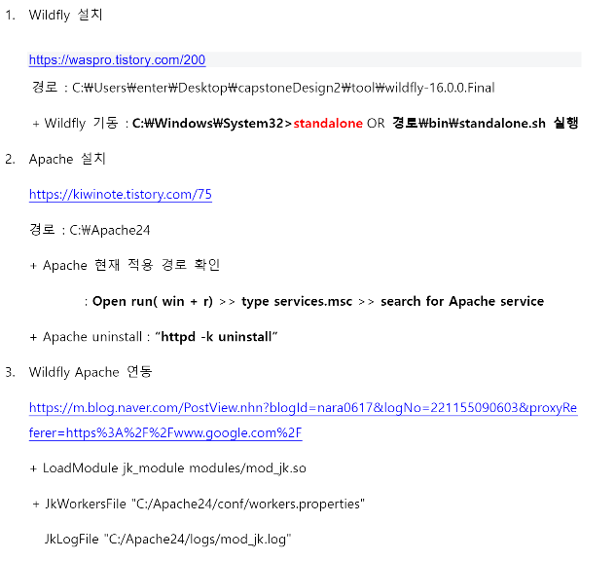
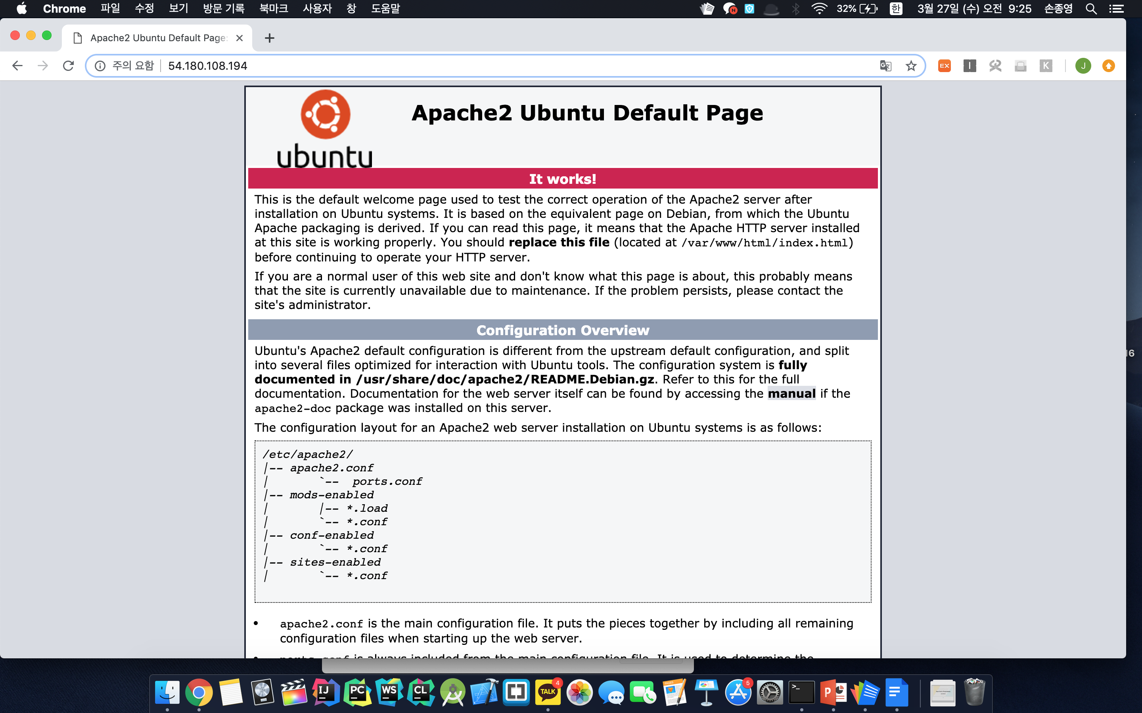
Ⅱ. About Project
Project Progress
Server construction
Studying

Slide 13
Ⅲ. Timeline
Paper Plan
Project Plan
Future Plan

Slide 14
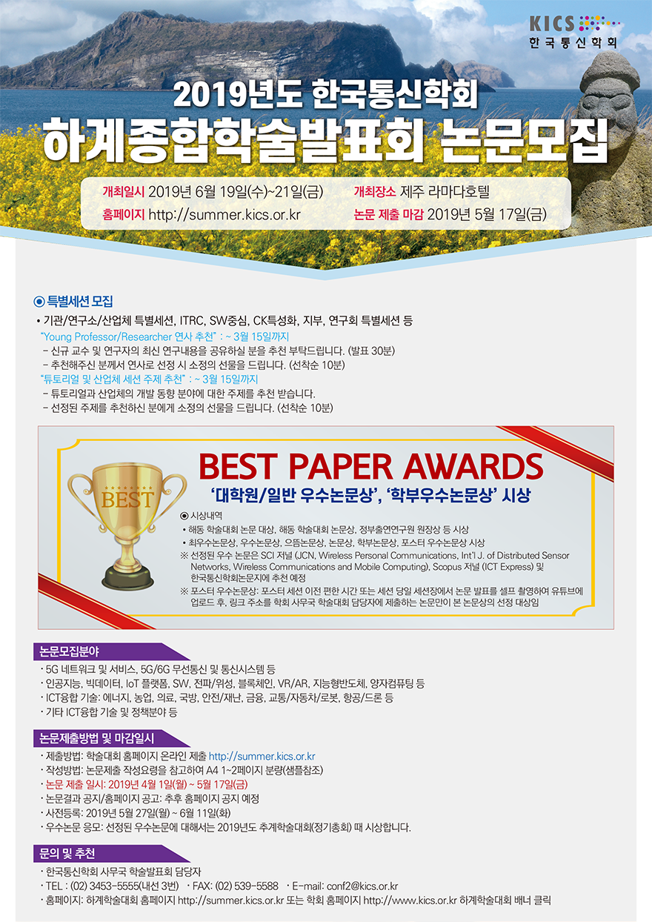
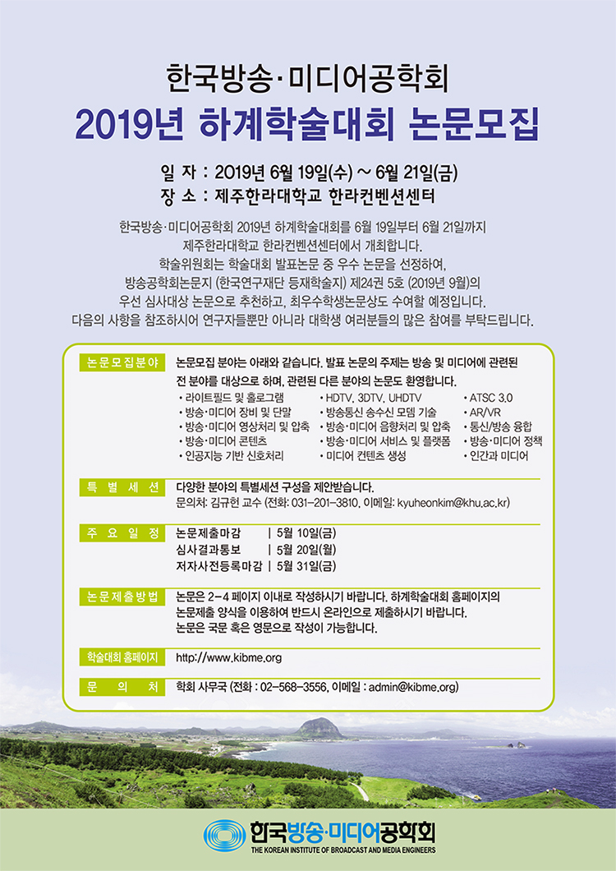

Ⅲ. Timeline
Previously...
offline meeting
- March -

Slide 15
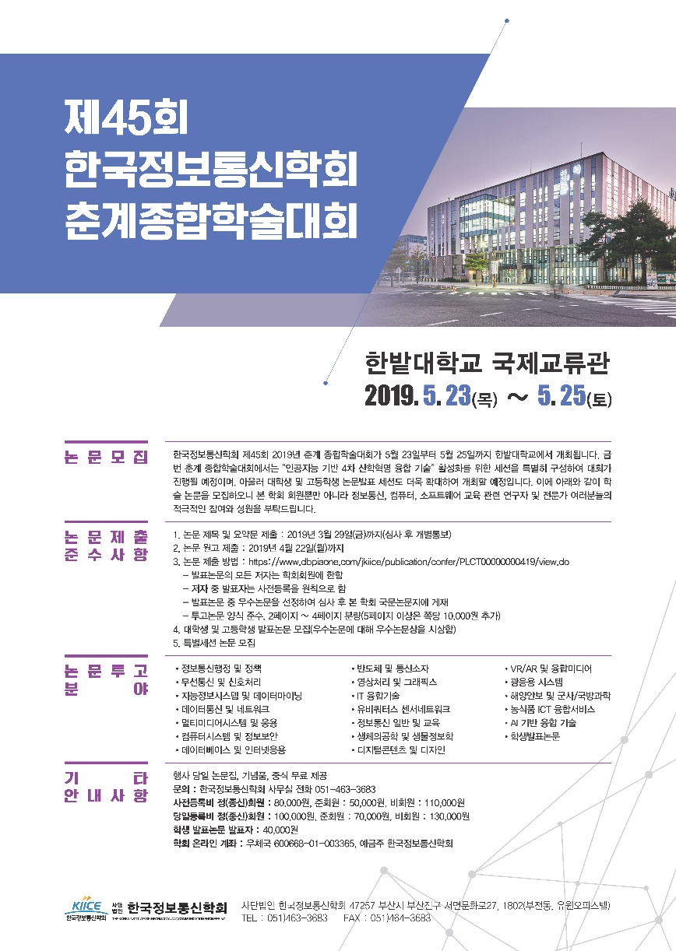
Ⅲ. Timeline
Paper Plan
Implementation and
fault-tolerance test of
a High Availability System
in a cloud environment
클라우드 환경에서의
고가용성 시스템 구현 및
결함 내성 시험

Slide 16
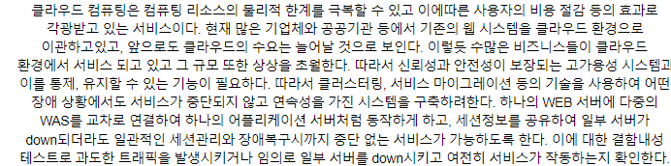
Ⅲ. Timeline
Paper Plan
Paper title and Summary : 3/29
Paper Manuscript : 4/22

Slide 17
Ⅲ. Timeline
Project Plan
 | Mar. |  |  |  | Apr. |  |  |  | May.
 | 2nd week | 3rd week | 4th week | 5th week | 1st week | 2nd week | 3rd week | 4th week | 1st week | 2nd week | 3rd week | 4th week | 5th week
Planning
Study about topic
Construct cloud environment
Construct WEB/WAS server
Clustering WAS server
Testing
Completion
Paper

Slide 18
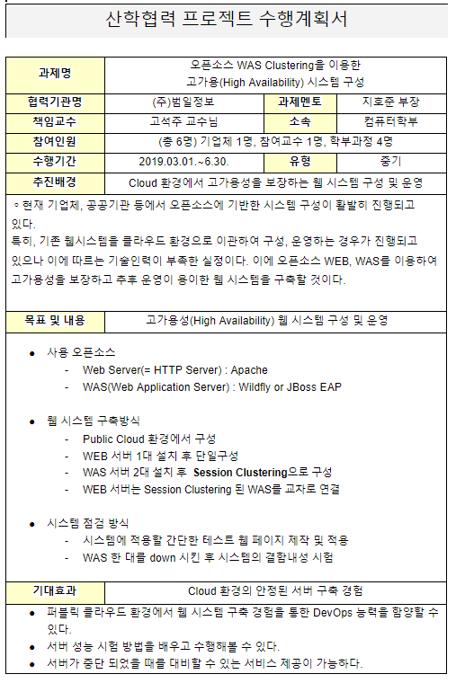
Ⅲ. Timeline
Future Plan
offline meeting
- April -

Slide 19




Ⅲ. Timeline
Future Plan
『WAS1』
『WEB』
『WAS2』
Construct 2 WAS server & Session Clustering
Cross-connect WEB server, WAS server

Slide 20
Q n A
Thank you

